Slide 1
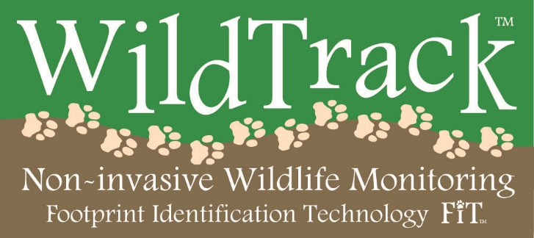

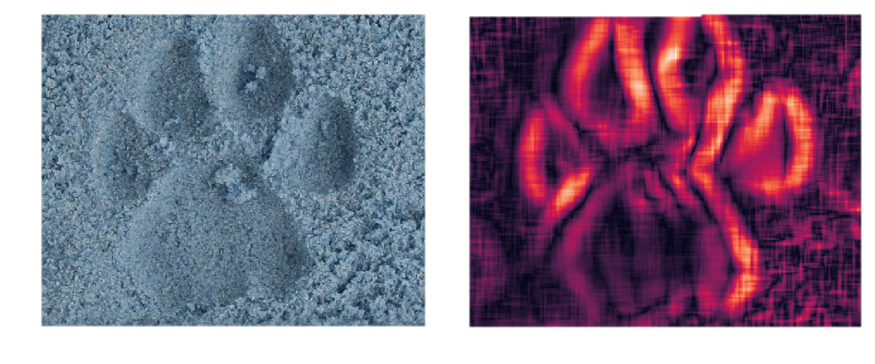
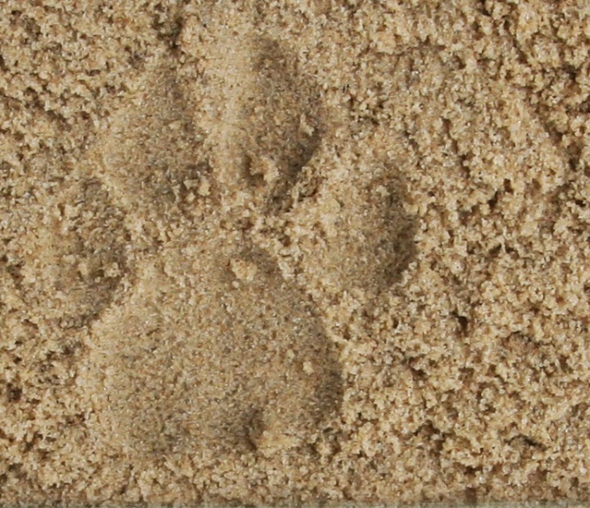
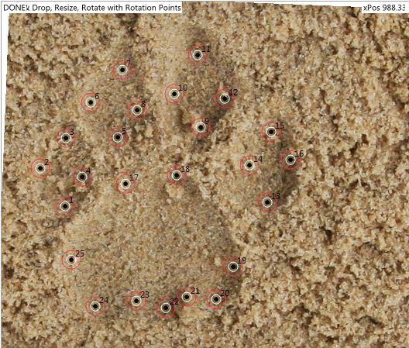
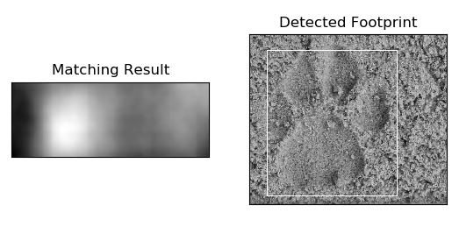
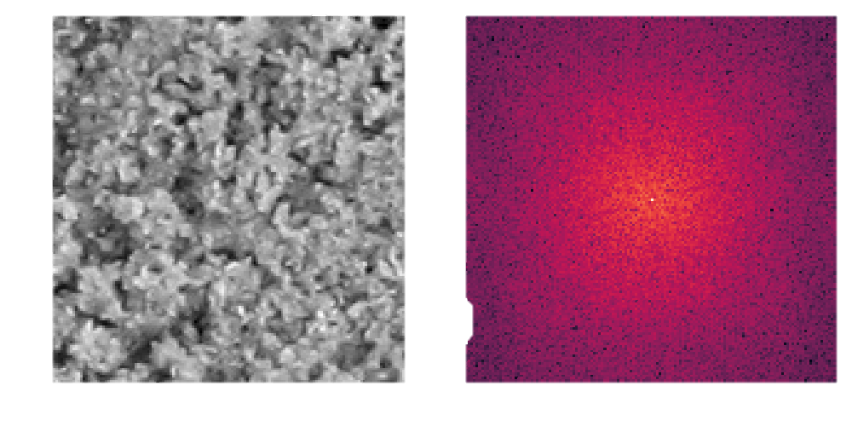
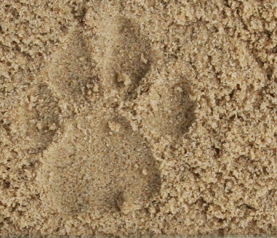
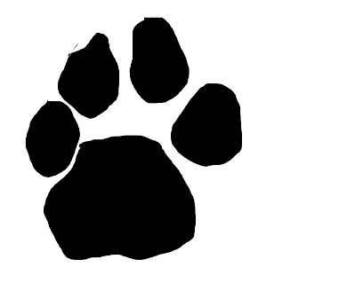
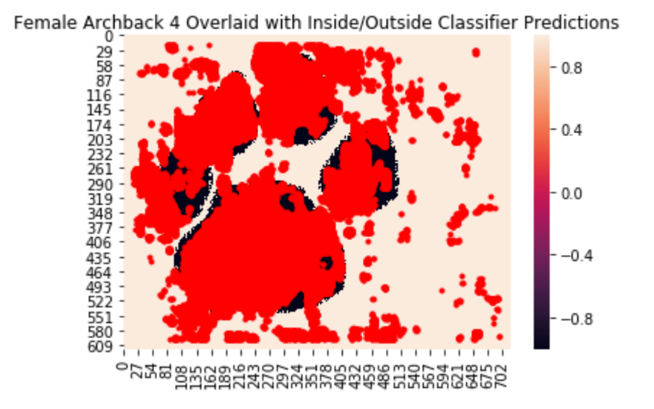
Convolutional Filtering using Signal Representations of Animal Paw Print Images for More Efficient Classification of Endangered Species
Feroze Mohideen
Advisor: Dr. Stacy Tantum
Data provided by Dr. Sky Alibhai and Dr. Zoe Jewell (WildTrack)
Background
Paw Print Isolation
Template Matching
WildTrack is a conservation group whose mission is to develop and implement non-invasive, community-friendly approaches to monitor endangered species, to understand how best to protect them and reduce human/wildlife conflict. Their non-invasive wildlife monitoring footprint identification technology (FIT) is used to identify behavior patterns among animals belonging to endangered species. An example of a footprint captured by a contributor to the project is found in Figure 1(a) below:
In order to identify animals solely based on their footprint signatures, landmarks at select locations within the print are manually placed and their x- and y-coordinates are measured, along with an array of other features. The landmarks are placed uniformly around areas of the print such that the relationship between each individual and his/her signature can be analyzed.
However, landmark placement is a manual, time-consuming and possibly error-prone procedure. This study formulates a pipeline to reliably automate the process, or at least make it easier to complete.
Speckle Filter Edge Detection
The idea behind template matching is to systematically morph a template image until it ‘fits’ optimally with an individual footprint. At this point, we know the ideal transformation of the template; if we place landmarks on the template image, we can find the unique landmarks for each individual footprint by mapping the template landmarks according to the transformation.
Currently, I have devised a system that uses a template to simply detect whether there exists a footprint within an image, and places a bounding box around it. I used the OpenCV library, which correlates a template image, like one of the masks generated in CNN training, with an arbitrary footprint:
In the future, I would like to extend this analysis to perform landmark tracking after footprint detection.
Naively apply smoothing and a traditional edge-detecting filter to isolate the outline of a print:
(a) (b)
Figure 2: (a) depicts a raw footprint image belonging to a male puma; (b) depicts the same image after being smoothed through bilateral filtering and scanned with a simple edge filter.
Frequency Domain Transformation
View the print and noise in the frequency domain, and design a low-pass filter that cancels out high frequencies in the noise:
(a) (b)
Figure 1: (a) depicts a raw footprint image belonging to a female puma; (b) depicts the same image with landmarks manually added to be used for classification.
(a) (b)
Figure 5: (a) displays the correlation of a template image with a footprint. The highest correlation value and the template image size is used to draw the bounding box in (b).
(a) (b)
Figure 3: (a) shows a patch of rough sand extracted from the image above; (b) shows the magnitude spectrum of the image signal in the frequency domain.
Convolutional Neural Network Training
Conclusions
Create masks of training images and sample frames from them to train an inside-the-footprint/outside-the-footprint classifier:
I explored three different approaches to solving the paw print isolation problem, each with different merits. The main barriers to accurate results were the drastically different conditions present in each image: lighting, sand texture, imprint depth among others. It is quite difficult to design an automatic system that accounts for this differentiation well enough to beat the human eye.
Objectives
Design a system that separates a paw print from noise in an image
Create a registration system that uniquely maps individuals to their footprints through template morphology
References
Methods
Jewell, Zoe, and Sky Alibhai. "Identifying endangered species from footprints." International Society for Optics and Photonics (SPIE) Newsroom 2013 (2013): 1-3.
Bradski, Gary, and Adrian Kaehler. Learning OpenCV: Computer vision with the OpenCV library. " O'Reilly Media, Inc.", 2008.
Paw Print Isolation
Speckle Filter Edge Detection
Frequency Domain Transformation
CNN Training
Acknowledgments
Template Matching
I would like to thank Dr. Alibhai and Dr. Jewell for introducing us to this project and the dataset. I would also like to thank my advisor, Dr. Stacy Tantum, and my peers, Dima Fayyad, Lucas Liu, and Caroline Potts, for their guidance and support.
Multi-scale template morphology using OpenCV
Figure 4: The top right image represents a mask generated by hand from the training sample in the top left. The bottom image displays predictions for inside/outside, with red indicating inside.

